Slide 1
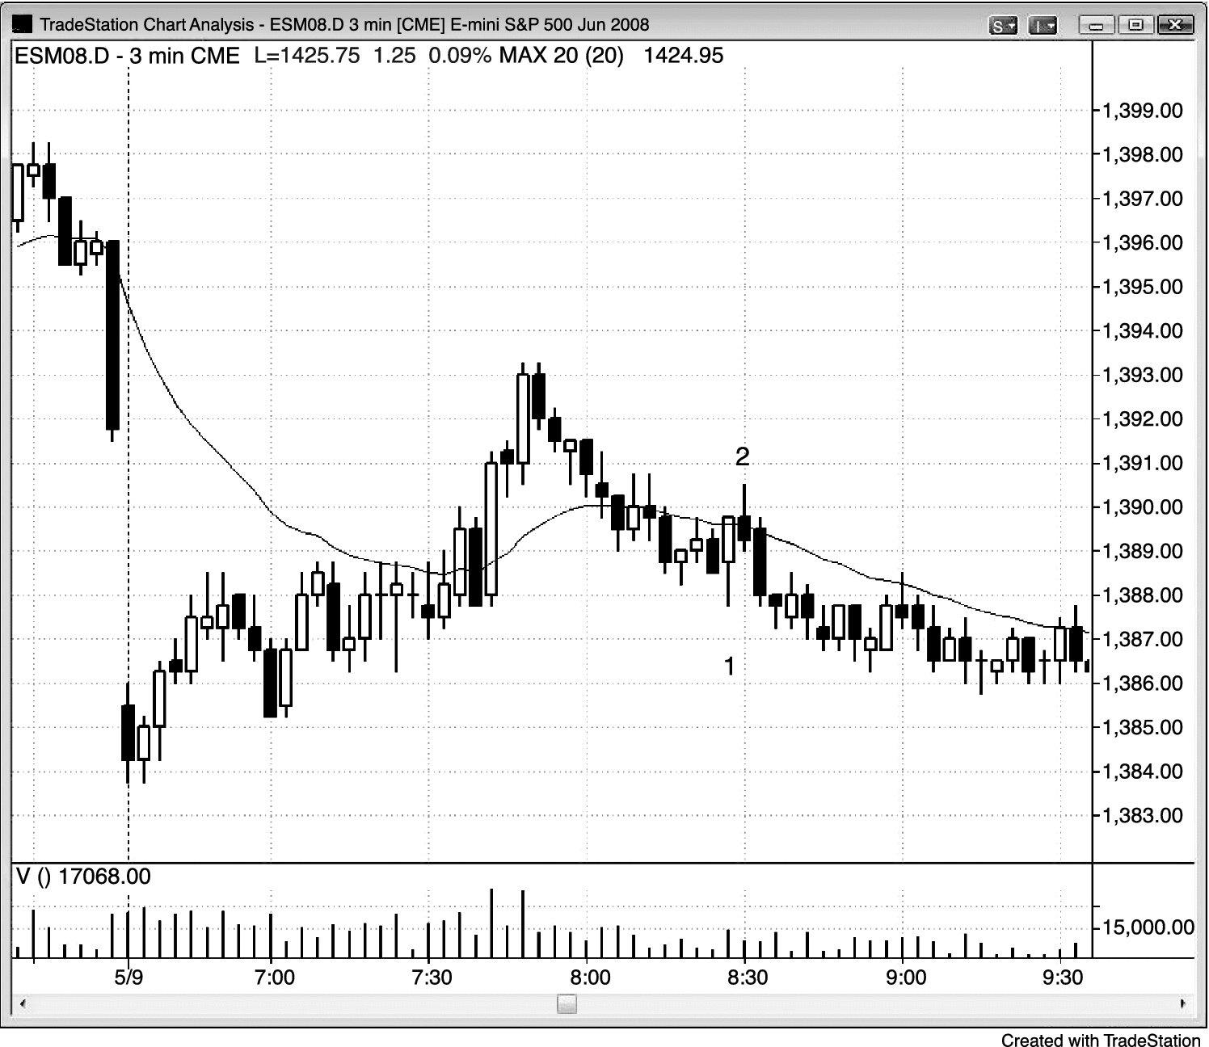
FIGURE 5.1 Reversal Bar in a Trading Range

Slide 2
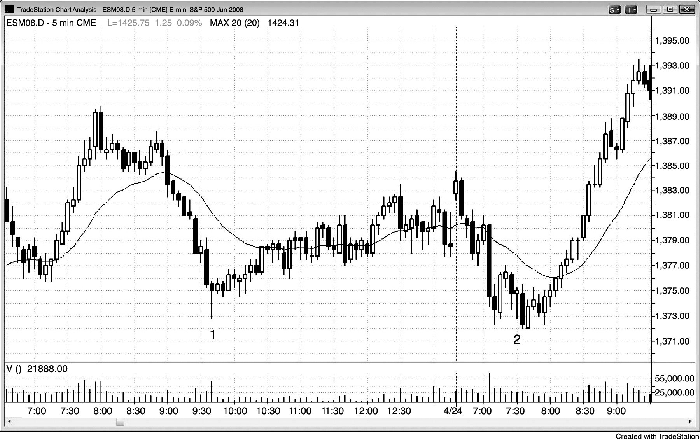
FIGURE 5.2 Reversal Bar with Big Tail and Small Body

Slide 3
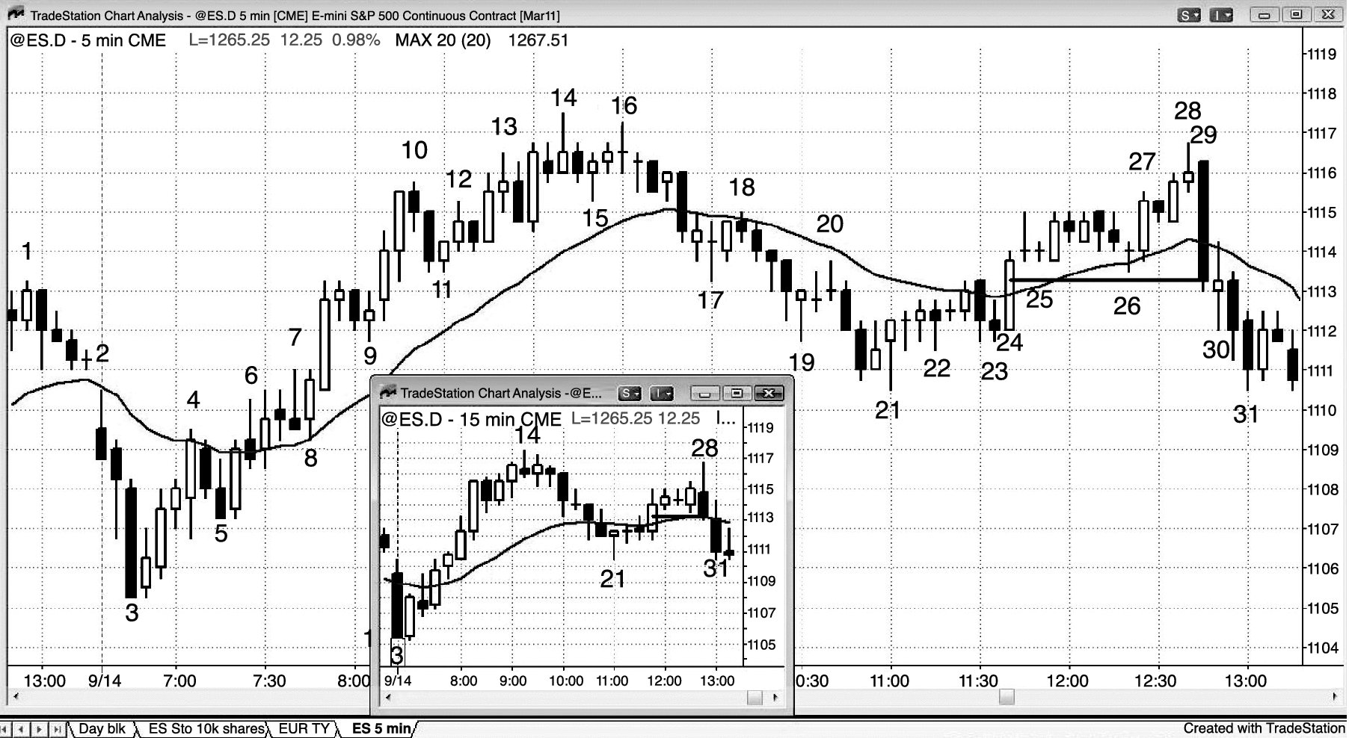
FIGURE 5.3 Reversal Bars Can Be Unconventional

